Slide 1

Swiggy Data Analysis Dashboard
Using Power BI to Gain Insights into Restaurant Performance and Delivery Efficiency
Presented by
Vaishakhi Gade

Slide 2
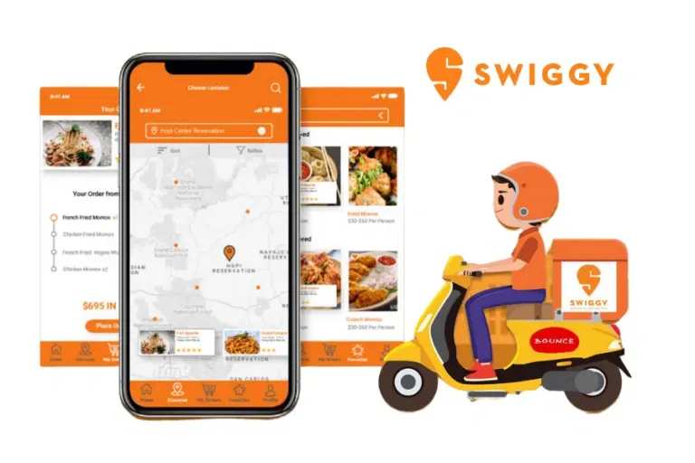
What is Swiggy?
Introduction
Swiggy is a leading food delivery service in India.
It connects customers with their favorite restaurants, delivering food across various cities.
With so many daily orders, restaurants, and deliveries, Swiggy generates a lot of data.
Analyzing this data helps improve customer satisfaction, delivery times, and restaurant partnerships.

Slide 3
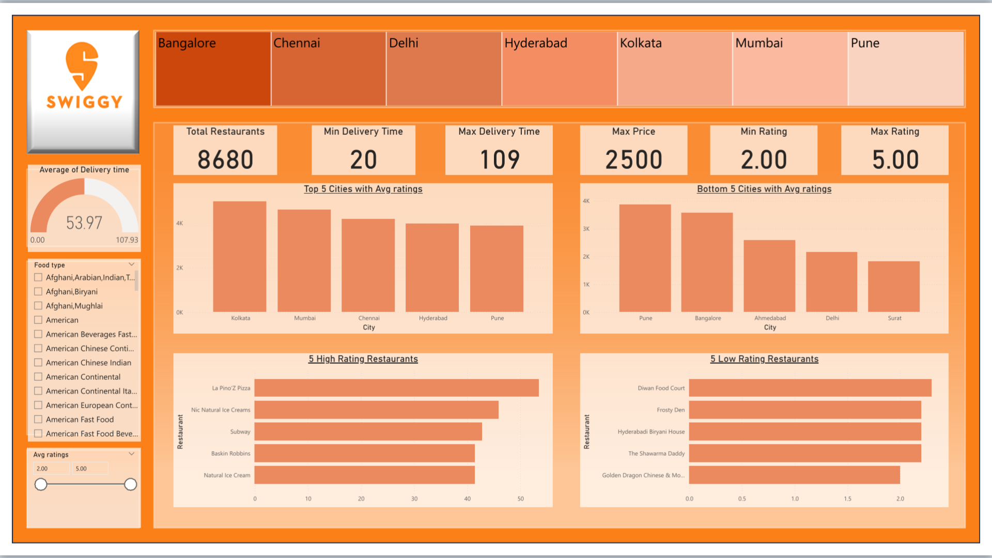
Why Analyze Swiggy’s Data?
Project Overview
The aim is to find trends and insights from Swiggy’s data to help improve
Restaurant ratings and customer satisfaction.
Delivery times and logistics efficiency.
This project focuses on analyzing restaurant performance in multiple cities to draw meaningful conclusions.

Slide 4
Project Goals
Understand which cities and restaurants have the best and worst ratings.
Understand which cities and restaurants have the best and worst ratings.
Analyze delivery times to improve efficiency.
Provide insights that help Swiggy make better business decisions.
Visualize the data in an easy-to-understand dashboard.

Slide 5
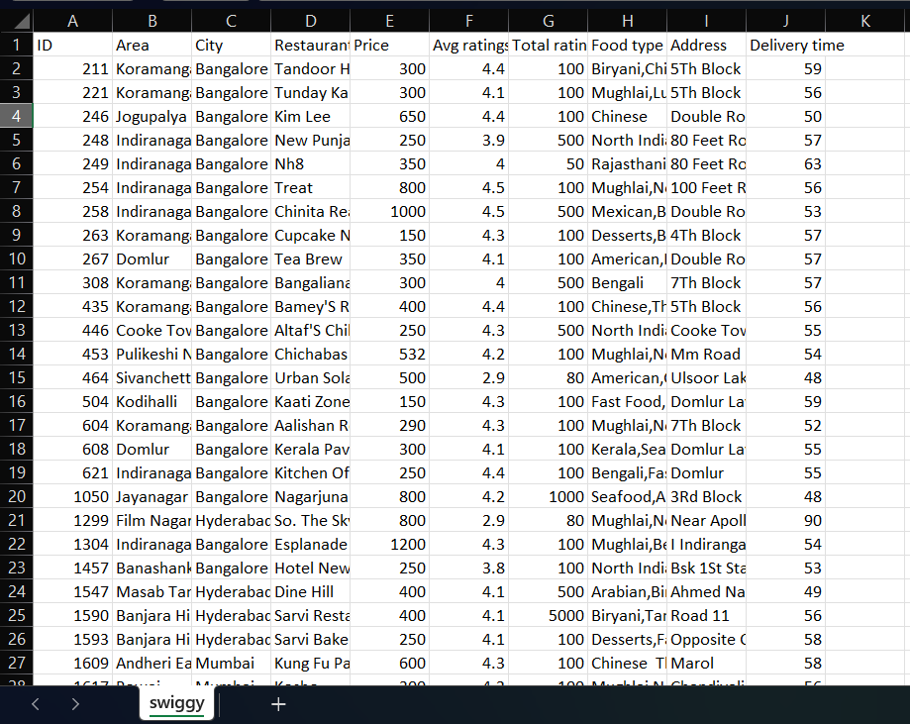
Where Did the Data Come From?
Data Collection & Sources
Source: The data was taken from Kaggle (a popular data platform).
Format: The dataset was in a CSV file and included details like:
Restaurant names, types of food, and ratings.
Delivery times, prices, and city locations.
Tool Used: Power BI was used to build the final dashboard and create visualizations.

Slide 6
Preparing the Data
Preparing the Data
Before analyzing the data, it had to be cleaned and structured.
Data Cleaning: Removed missing values, fixed inconsistencies.
Transformation: Formatted the data to make it ready for analysis in Power BI.
After these steps, the data was ready for visualization.

Slide 7
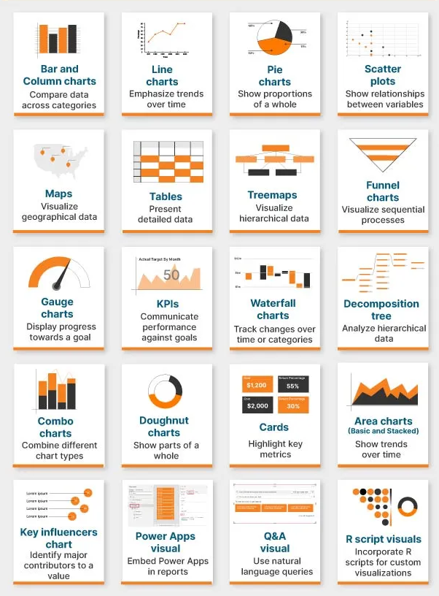
Visualizations Used
Types of Visualizations
Different charts and graphs were created to make the data easier to understand:
Bar Charts: Compare restaurant ratings and delivery times by city.
Gauge Charts: Show delivery time and satisfaction metrics.
Cards: Highlight key figures (e.g., total restaurants, average ratings).
Column Charts: Show how cities perform in terms of restaurant ratings and delivery times.
Slicers: Allow users to filter data by city, food type, and restaurant.
Treemaps: Group restaurants by type and performance.

Slide 8
Key Insights What Did We Discover?
Top Cities: Kolkata, Mumbai, and Chennai had the best restaurant ratings.
Fastest Deliveries: Hyderabad and Pune had the quickest delivery times.
Best Restaurants: La Pino’z Pizza and Natural Ice Cream were top performers.
Areas for Improvement: Cities like Delhi and Bangalore showed longer delivery times, and certain restaurants had lower ratings.

Slide 9
Business Impact How Can Swiggy Benefit from These Insights?
Business Impact How Can Swiggy Benefit from These Insights?
Improve Delivery Times: Focus on cities with slow deliveries to improve logistics.
Restaurant Partnerships: Help underperforming restaurants improve service to increase customer satisfaction.
Resource Allocation: Allocate more delivery partners to cities with higher demand or slower deliveries.
Customer Experience: Use insights to enhance customer satisfaction and loyalty.

Slide 10
Conclusion
The Swiggy data analysis project provides clear insights into city-wise and restaurant performance.
The Power BI dashboard simplifies complex data and helps Swiggy make better business decisions.
Through this project, we’ve shown how data analysis can help improve operations and customer satisfaction in the food delivery industry.

Slide 11
Thank You!

